Slide 1


London: City of Languages.
Poster Competition!
https://londoncityoflanguages.org.uk/
Celebrating the superpower of languages used and studied in London

Slide 2
‘London Festival of Languages 2026’
London: City of Languages is coordinating a ‘London Festival of Languages 2026’.
The Festival will include a wide variety of activities, both online and face to face, when we can celebrate the rich diversity of languages used, studied, and loved across our city.
Notes:
Introduce with enthusiasm. Ask pupils what languages they know.

Slide 3
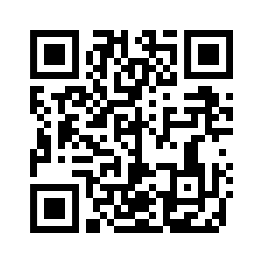
🎨 What’s the Competition?
We need YOUR HELP to design posters to display in
schools,
cultural organisations and
public spaces (e.g. libraries)
to encourage people to go to our Festival of Languages Page on the website to find out what is on offer.
DEADLINE: Wednesday 6th May 2026
Notes:
Explain logos. Show examples.
https://logo.com/blog/famous-logos

Slide 4

What to include in the poster …
“London Festival of Languages, Summer 2026”
“Find out more:” followed by a QR code (see above) or web address: londoncityoflanguages.org.uk/festival/
(3) Images/ text which celebrate the multiplicity of languages spoken and used in London (rather than nations / countries / flags)
(4) Optional: Images associated with Festival activities (e.g. talks, displays, making videos, quizzes & competitions, language learning, story telling, the arts (music, dance, drama) etc.)

Slide 5
🏆 Judging + Recognition!
Posters will be judged on creativity and representation of London as a City of Languages
Winning posters will feature on our website and can be downloaded. We will add our logo to them.
Winners will receive a printed or framed copy of their poster
All participants receive a certificate
A gallery of selected entries will be displayed online.
Notes:
Motivate with prizes.

Slide 6
How to Enter
🖍️Draw your poster on paper or a computer
📐 Make it fit A4 or A3.
📅 Give it to your teacher
Notes:
Clarify deadline and format.

Slide 7

💡 Ideas to Get Started
Think about London and all its languages.
What pictures show talking, sharing, or learning?
Use your imagination!
Notes:
Run a brainstorm session.

Slide 8

Let’s Get Creative!
You can use pencils, pens, paint, or computers. (Not AI!)
Ask your teacher if you need help.
Have fun!
Notes:
Encourage creativity and support.

Slide 9
Image & Assets Credits
  Slide 3 Map created by UCL’s Oliver O’Brien 2014
  Slide 3: Icons sourced from freepik used under free licence [3 with speech bubbles + words) + Stock photo from Unsplash used under free licence - Jacqueline Brandwayn (plants + words) + EDOL icon
  Slide 5 – logos from blogpost https://logo.com/blog/famous-logos
  Other images from Microsoft

