Slide 1
Underground Overground Languages - PSHE lesson
Kindly shared by Dr Catherine Ames
London: City of Languages, Steering Group
The Grey Coat Hospital, C of E Comprehensive School for Girls.
These slides stimulate thought about London as a City of languages and can be combined with the Logo competition launch.

Slide 2
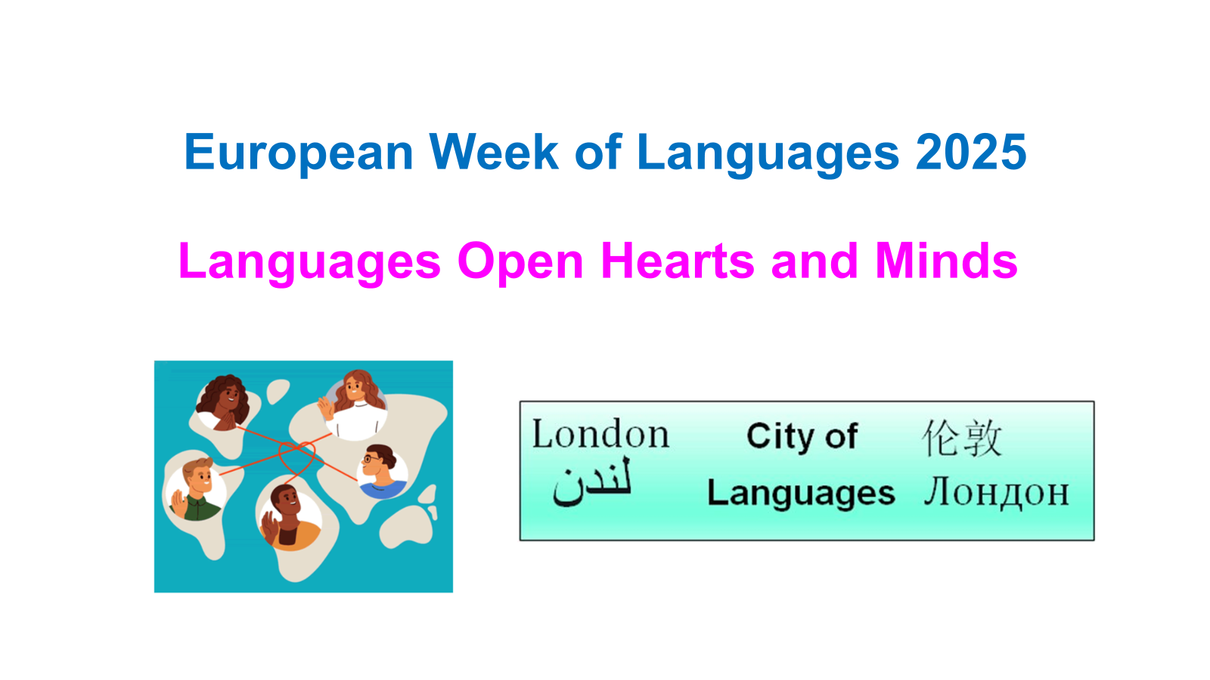
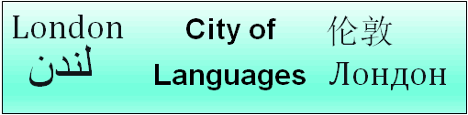
London: City of Languages Welcome!
https://londoncityoflanguages.org.uk/
Celebrating the superpower of languages in London

Slide 3
London: City of Languages Welcome!
https://londoncityoflanguages.org.uk/
Celebrating the superpower of languages in London

Slide 4
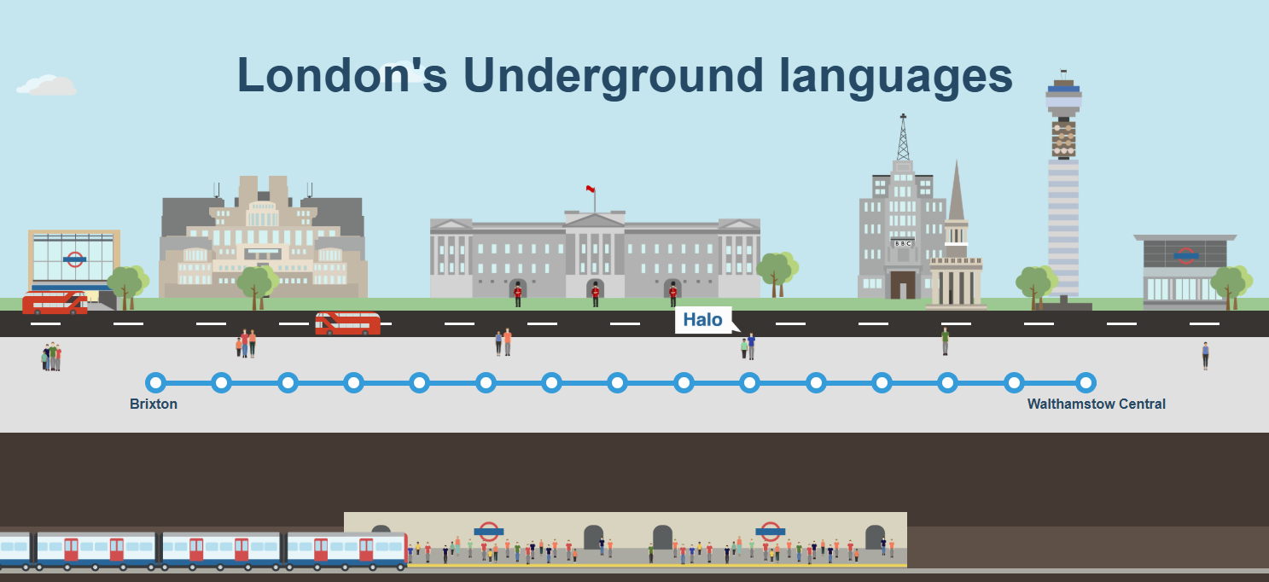
Hurtling deep underground in a Tube train, it can be hard to picture the streets overhead, and harder still to learn much about their eight million inhabitants. But London is one of the most linguistically interesting cities in the world, with more than 100 languages in use across the city.

Slide 5

A journey through language
Watch the clip called about how
many languages are spoken on the route of the Victoria Line and
see how many you recognise.
https://www.bbc.co.uk/news/resources/idt-1e4fbcb9-5bd6-4e14-adf5-bf3ab1ba79bb

Slide 6
What are the 10 most widely-spoken languages in London other than English?
Polish - 147787
Bengali - 114152 (typically from Bangladesh and Indian West Bengal)
Gujarati - 101667 (mostly from Indian Gujarat)
French - 84036 (will include French speakers from former French colonies)
Urdu - 78667 (typically from Pakistan and Northwest India)
Portuguese - 71748 (will include Brazilians and other ex-Portuguese colonies)
Turkish - 71229
Spanish - 71065 (will include South Americans and ex-Spanish colonies)
Arabic - 70577
Tamil - 70556 (typically from Indian Tamil Nadu and Sri Lanka)

Slide 7
Now to quiz you on how well you know London’s linguistic geography…

Slide 8
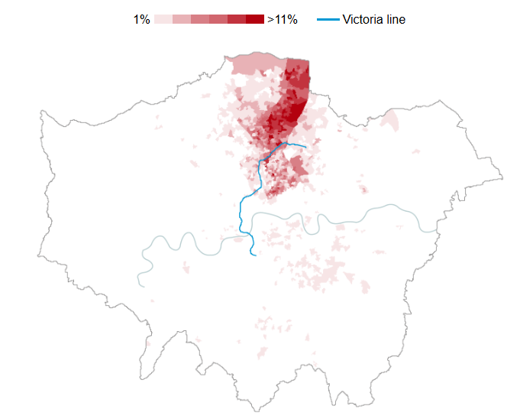
What language is represented here as the main language spoken by the people who live there?

Slide 9
Turkish
Turkish is one of the most popular languages along the stretch of the Victoria Line from Finsbury Park to Tottenham Hale.
London's Turkish speakers can be found almost entirely in just three boroughs - Hackney, Haringey and Enfield – on the west bank of the River Lee, which flows down from the outskirts of north-east London via Stratford into the Thames.

Slide 10
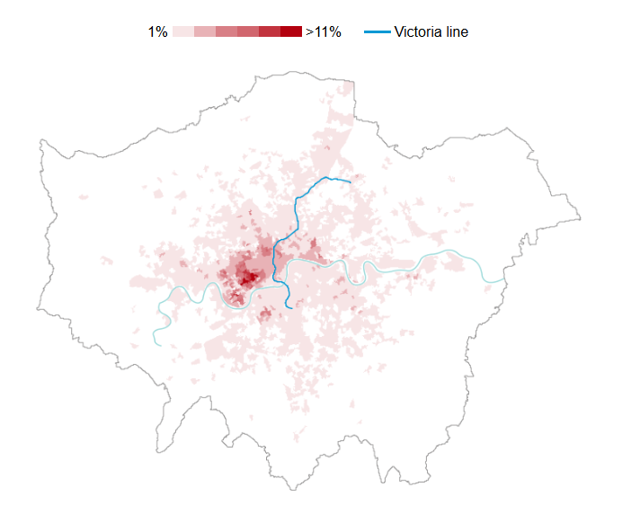
What language is represented here as the main language spoken by the people who live there?

Slide 11
French
French is the most evenly distributed of the Victoria Line's languages.
Why? Oliver O'Brien, a researcher at UCL's department of geography who has previously studied the data, says that new arrivals from France would not feel the same need to cluster around their peers as others from further afield because London would probably already feel very familiar.

Slide 12
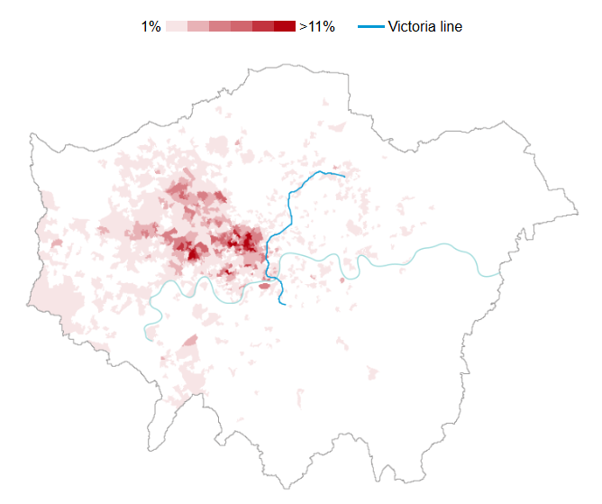
What language is represented here as the main language spoken by the people who live there?

Slide 13
Arabic
Businesses catering to Middle Eastern tastes are most conspicuous in London along stretches of Edgware Road. Around here, the proportion of native Arabic speakers reaches 23% in parts.
But many of London's most central areas, especially to the west of town, also have a substantial Arabic-speaking population. In the area immediately surrounding Green Park station, for instance, just over 6% of residents mainly speak Arabic. Here property is among the costliest in the world.

Slide 14
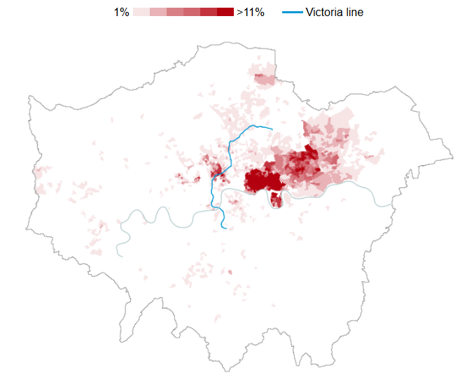
What language is represented here as the main language spoken by people who live there?

Slide 15
Bengali
Over 20% of people in some areas around Euston and King's Cross said Bengali was their main language.
But the area where Bengali is most dominant is Tower Hamlets, the borders of which are almost perfectly delineated by the darkest shades of red on the map to the east of the Victoria Line. A secondary population just to the east is only slightly less loyal to the borough of Newham.
In some parts of Tower Hamlets the proportion of people speaking Bengali as a first language tops 38% - a far higher rate than can be found in London for any of the other languages along the Victoria Line.

Slide 16
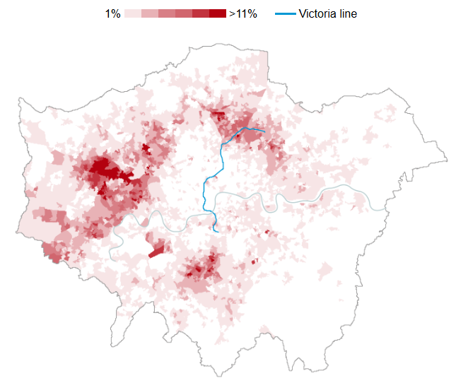
What language is represented here as the main language spoken by the people who live there?

Slide 17
Polish
London property was already very costly in 2004 when Poland joined the European Union and has continued to soar in value since then. This might partly explain why Polish speakers have tended to cluster in the suburbs.

Slide 18
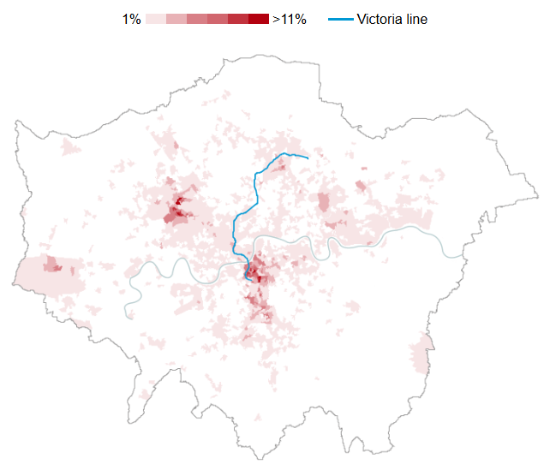
What language is represented here as the main language spoken by the people who live there?

Slide 19
Portuguese
The southern end of the Victoria Line, particularly between Stockwell and Vauxhall, has long been the focal point of London's Portuguese-speaking community, which has grown exponentially in recent decades and begun to spill over into nearby Brixton.

