Slide 1

London: City of Languages. Welcome!
https://londoncityoflanguages.org.uk/
Celebrating the superpower of languages used and studied in London

Slide 2

🎉Design the Official Logo for London: City of Languages
London is full of amazing people who speak and use lots of different languages.
Now YOU get to help celebrate that by designing a special logo!
Notes:
ntroduce with enthusiasm. Ask pupils what languages they know.

Slide 3






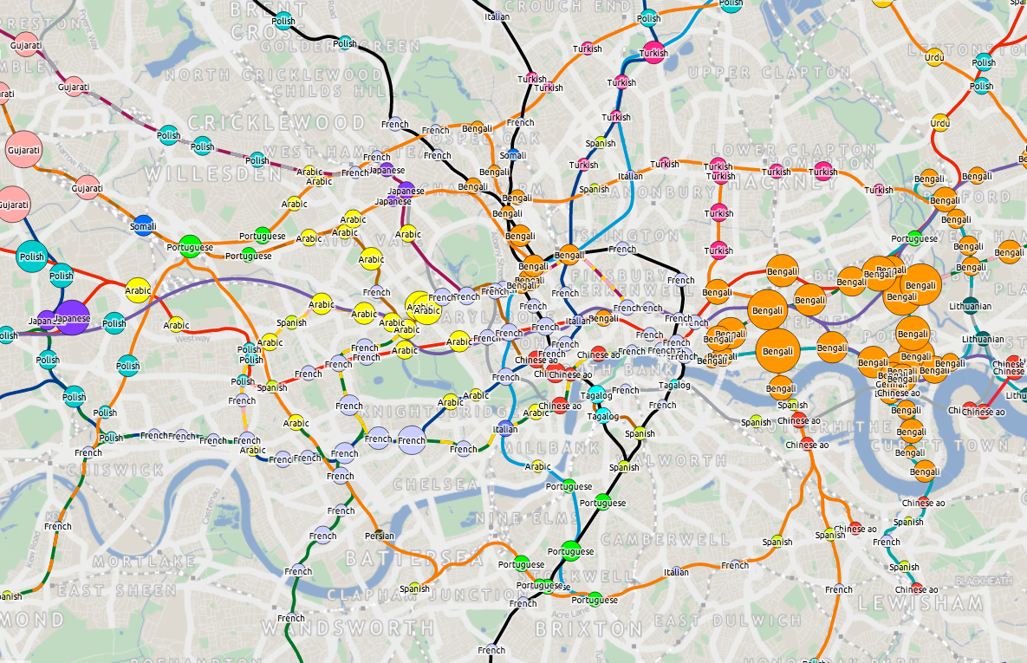
🌍 What Is London: City of Languages?
A celebration of the incredible diversity of languages spoken, studied, and lived across London.
Map created by UCL’s Oliver O’Brien 2014
Notes:
Discuss London’s diversity. Share greetings.
https://www.london.gov.uk/who-we-are/what-london-assembly-does/questions-mayor/find-an-answer/languages-0
https://www.mylondon.news/news/real-life/fascinating-maps-show-most-popular-30015859
https://www.ndtv.com/feature/this-south-asian-language-is-the-most-spoken-foreign-language-in-london-6410685
https://www.theguardian.com/news/datablog/2014/oct/30/-sp-londons-tube-languages-visualised

Slide 4


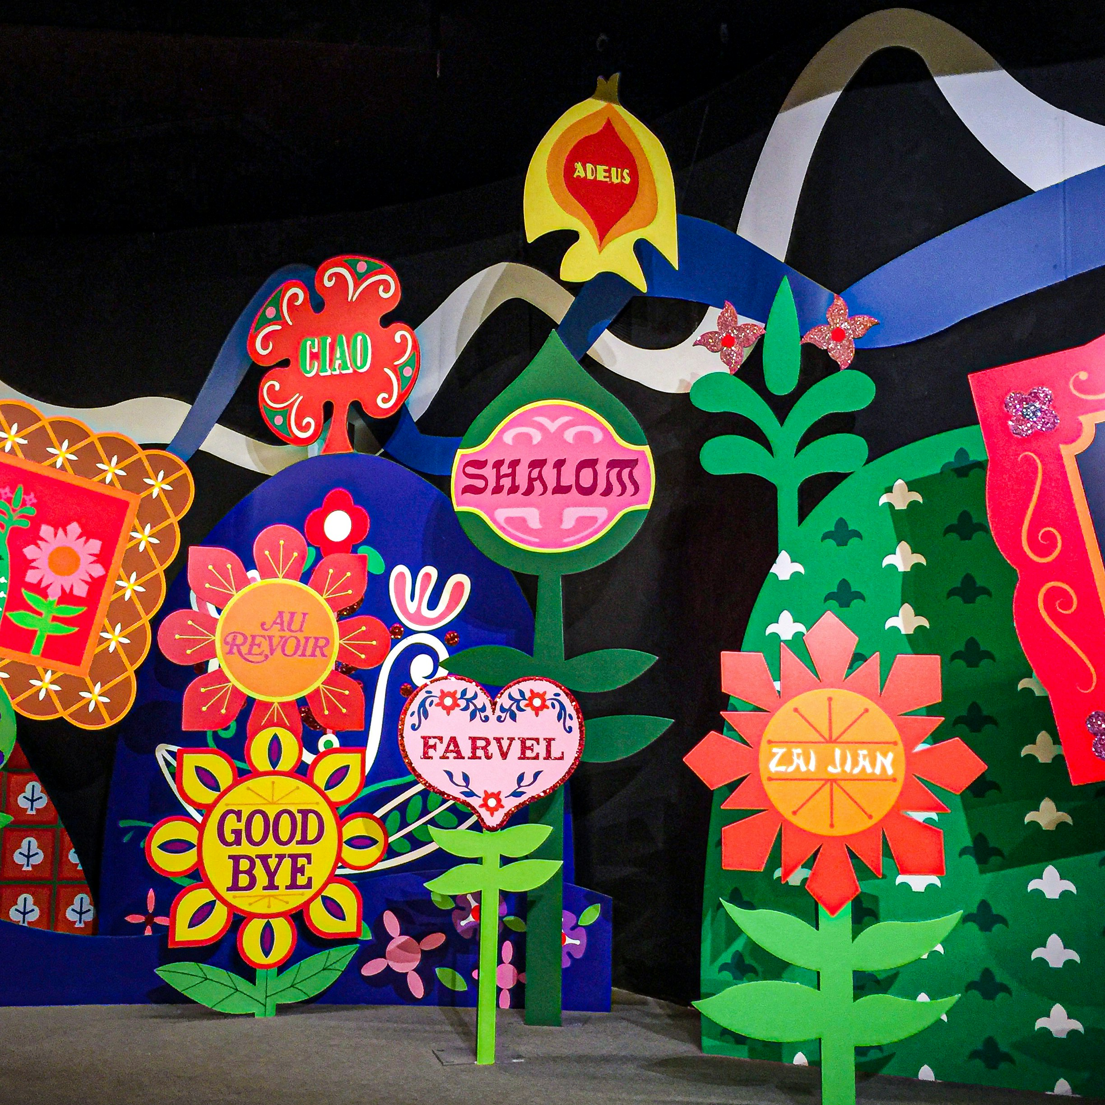



🎨 What’s the Competition About?
Design a logo that reflects London’s linguistic richness.
Winning design featured in official materials.
All entries receive a certificate; many will be featured online
Notes:
Explain logos. Show examples.

Slide 5







What You Could Win
🏅 Recognition across the city 📜 Certificate of participation 🖼️ Featured in an online gallery 🖌️ Framed version of your logo
Logos from post https://logo.com/blog/famous-logos
Notes:
Motivate with prizes.

Slide 6
Key Info
Detail | Info
Who | Pupils in London Schools
Deadline | Monday 3rd November
Format | Square (1:1), JPEG/PNG/PDF/GIF, max 5MB
Submission | Via teacher using online form
Notes:
Clarify deadline and format.

Slide 7
✅ Logo Design Checklist
Original – Must be your own idea, not copied from elsewhere.
Easy to spot – Can someone recognise it in 3 seconds?
Clear message – Does it show what London: City of Languages is about?
Timeless – Will it still look good in a few years?
Keep it simple – Avoid too many images or text.
Colours – Do they look good together and also work in black & white?
Works everywhere – Does it look good both small (badge) and large (poster)?
Format – Create the logo in a square (1:1) format.
Notes:
Review tips with examples.

Slide 8



💡Creative Direction
What does ‘London: City of Languages’ mean to you?
Think about colour psychology and typography.
Note: it can be an image. No words required.
Notes:
Run a brainstorm session.

Slide 9


🧠 Brainstorming Activity
Group discussion: What images or ideas represent multilingual London?
Sketch session: Draft 2–3 concepts
Peer feedback: Share and refine
Notes:
Run a brainstorm session.

Slide 10

📤How to Submit
Make sure it’s in the right format (square)
Scan or photograph clearly
Save as a unique filename (your teacher will advise)
Teachers will upload your design

Slide 11
🎯Final Thoughts
Your design could represent London’s voice to the world.
Be bold, be thoughtful, be creative.
THANK YOU for participating.
Notes:
Encourage creativity and support.

Slide 12
Image & Assets Credits
Slide 3 Map created by UCL’s Oliver O’Brien 2014
Slide 4 Icons sourced from freepik used under free licence [3 with speech bubbles + words) + Stock photo from Unsplash used under free licence - Jacqueline Brandwayn (plants + words) + EDOL icon
Slide 5 – logos from blogpost https://logo.com/blog/famous-logos
Other images from Microsoft

