Slide 1

London: City of Languages.
Welcome!
https://londoncityoflanguages.org.uk/
Celebrating the superpower of languages used and studied in London

Slide 2

🌟Let’s Design a Logo for London!
London is full of amazing people who speak and use lots of different languages.
Now YOU get to help celebrate that by designing a special logo!
Notes:
Introduce with enthusiasm. Ask pupils what languages they know.

Slide 3

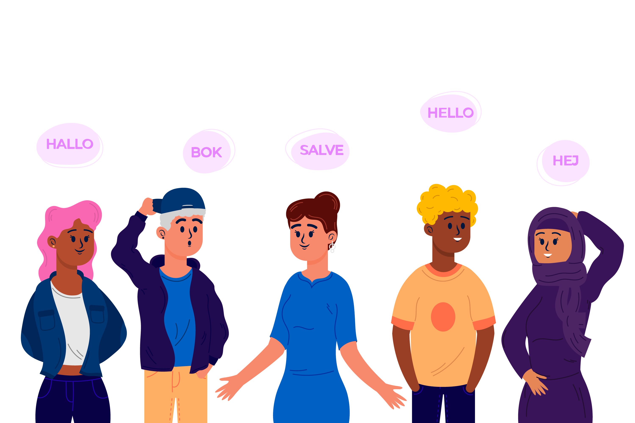
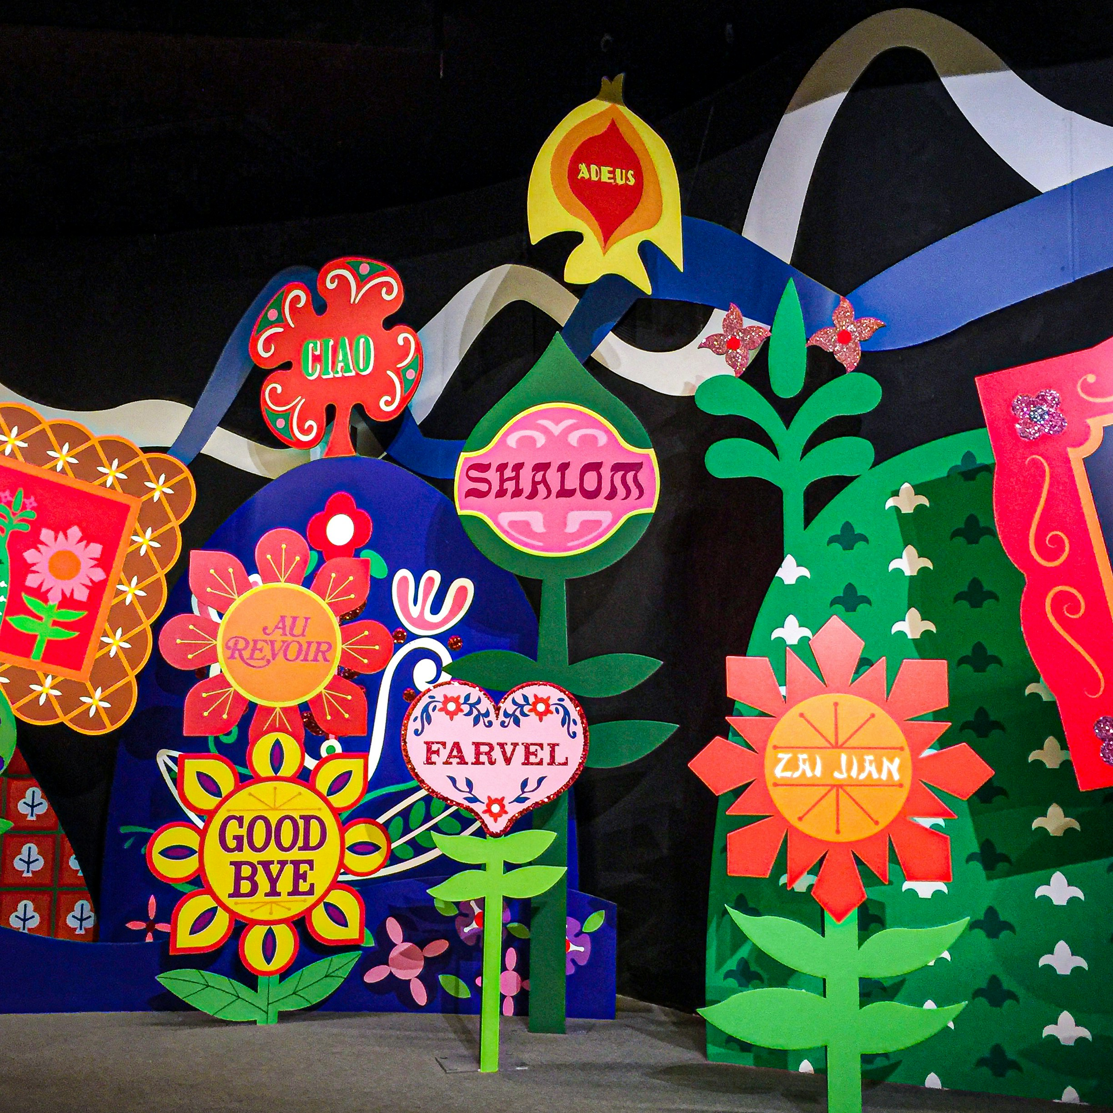

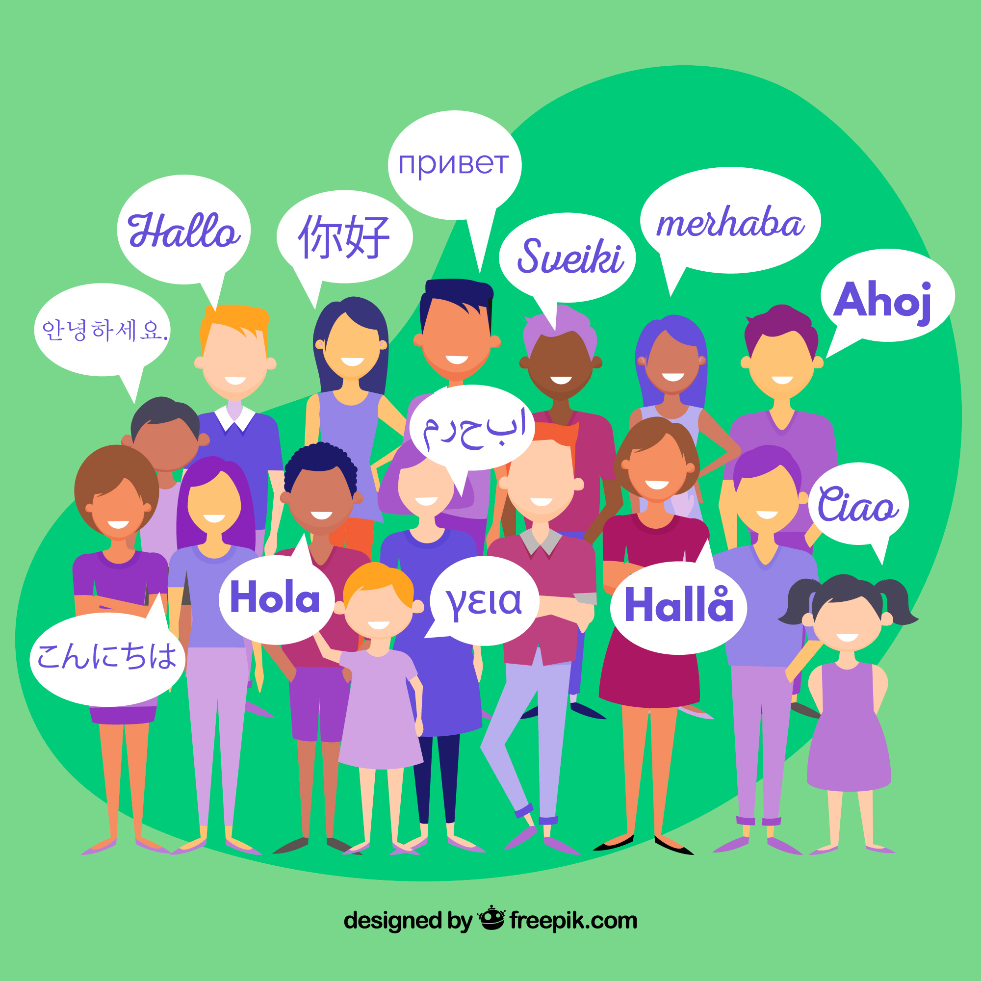

🗺️ What Is London: City of Languages?
Over 300 different languages are spoken in London.
This project celebrates all the amazing ways we talk!
Notes:
Discuss London’s diversity. Share greetings.

Slide 4












🎨 What’s the Competition?
We need YOUR HELP to design a logo—a special picture that shows what London: City of Languages means!
Notes:
Explain logos. Show examples.
https://logo.com/blog/famous-logos

Slide 5

🏆 Prizes!
🎉 Your logo could be famous!
📜Everyone gets a certificate.
🖼️ Lots of designs will be shown online!
Notes:
Motivate with prizes.

Slide 6
How to Enter
🖍️Draw your logo on paper or a computer
📐 Make it a square shape.
📅 Give it to your teacher before Monday 3rd November !
Notes:
Clarify deadline and format.

Slide 7
✅Logo Tips
👀 Easy to see
🧠 Smart idea
🎨 Nice colours
🧼 Not messy
🧩 Fits in a square
Notes:
Review tips with examples.

Slide 8

💡 Ideas to Get Started
Think about London and all its languages.
What pictures show talking, sharing, or learning?
Use your imagination!
Notes:
Run a brainstorm session.

Slide 9

Let’s Get Creative!
You can use pencils, pens, paint, or computers. (Not AI!)
Ask your teacher if you need help.
Have fun!
Notes:
Encourage creativity and support.

Slide 10
Image & Assets Credits
  Slide 3 Map created by UCL’s Oliver O’Brien 2014
  Slide 3: Icons sourced from freepik used under free licence [3 with speech bubbles + words) + Stock photo from Unsplash used under free licence - Jacqueline Brandwayn (plants + words) + EDOL icon
  Slide 5 – logos from blogpost https://logo.com/blog/famous-logos
  Other images from Microsoft

