Slide 1
Geometry, art and the Arab World
Kindly shared by Dr Catherine Ames
London: City of Languages, Steering Group
The Grey Coat Hospital, C of E Comprehensive School for Girls.

Slide 2


European Week of Languages 2025 Languages Open Hearts and Minds

Slide 3
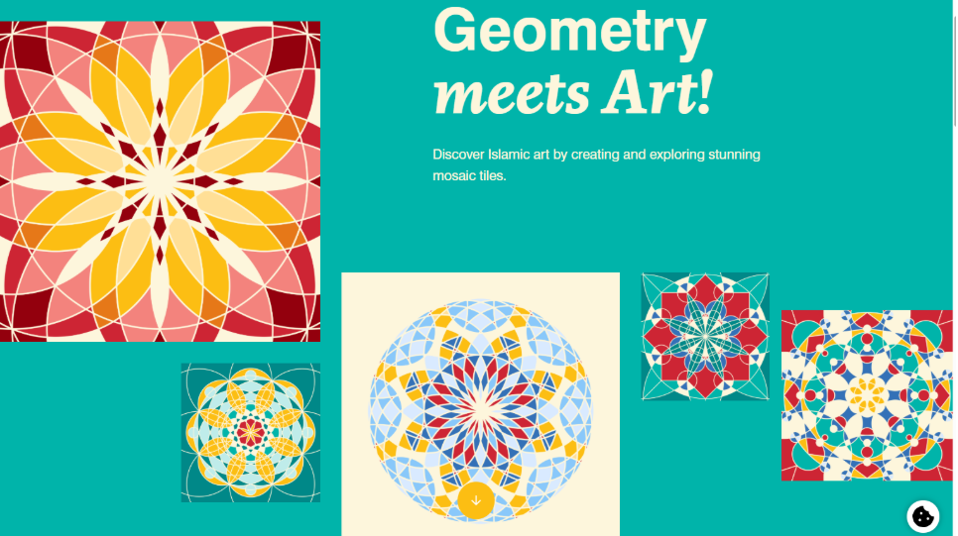
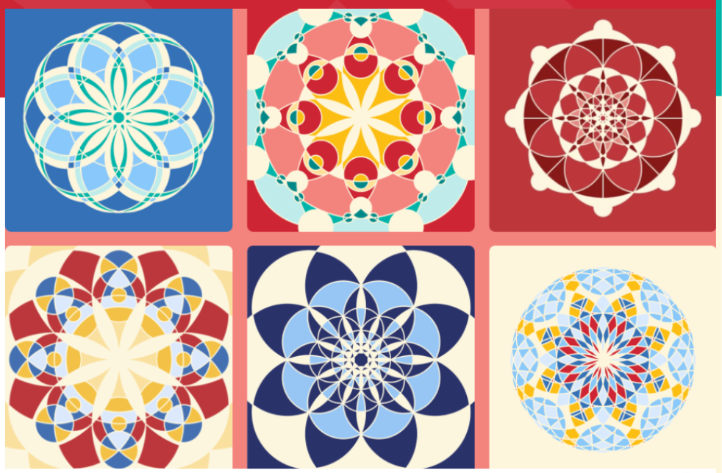
Geometry, Art and the Arab World

Slide 4
A Historical Look at Islamic Geometric Design
The "Arab world" (referring to Islamic cultures) has a rich heritage of integrating geometric patterns into art and architecture, often rooted in pre-Islamic traditions and elevated by mathematical symmetry and repetition to convey concepts of unity and the cosmos.
Islamic architecture is deeply rooted in geometric patterns, predominantly made with circles and lines. Let’s explore the early history of this artistic tradition…

Slide 5
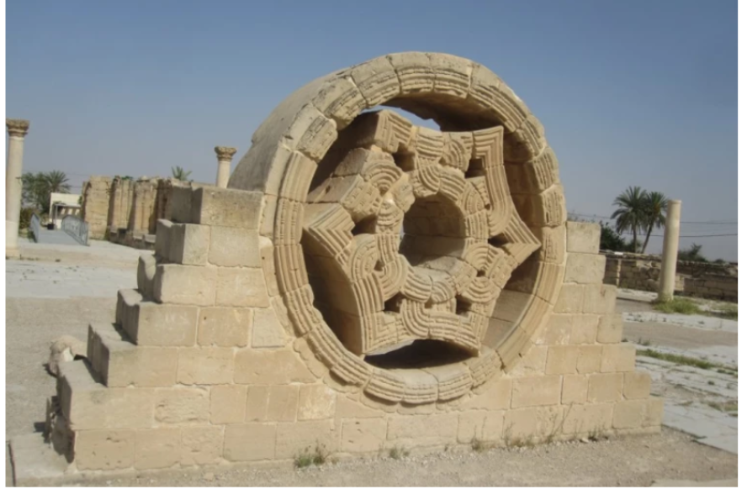
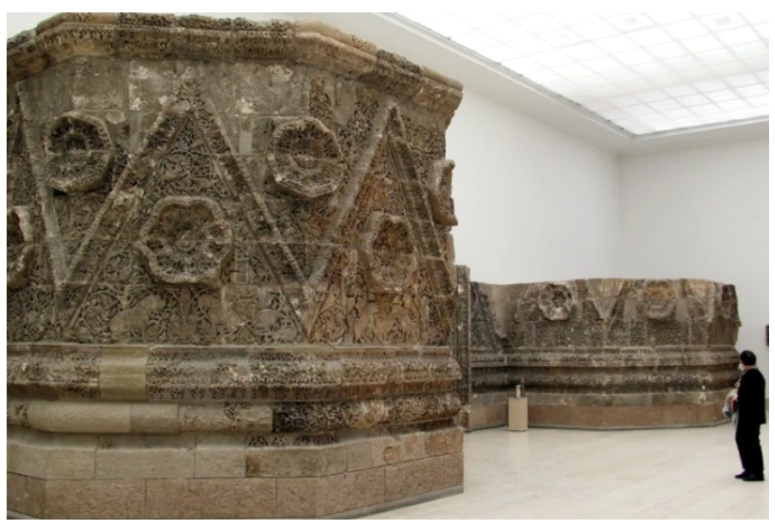
Discussion: What makes these pieces geometric?
Khirbat al-Mafjar quis nostrud exercitation ullamco.
Qasr al-Mshatta quis nostrud exercitation ullamco.

Slide 6
Khirbat al-Mafjar
The Umayyads (661–750) were the first Islamic dynasty, establishing palaces like Khirbat al-Mafjar near Jericho. This 8th-century palace features a large star-shaped design made of interlacing bands, drawing from Roman mosaic traditions. Unlike Roman designs, the geometric elements became the focal point, elevating them from a supporting role to centre stage.

Slide 7
Qasr al-Mshatta
Located in present-day Jordan, Qasr al-Mshatta is another early Islamic palace. Its exterior wall is adorned with intricate triangular geometric motifs — a testament to the early importance of geometry in Islamic architecture.

Slide 8
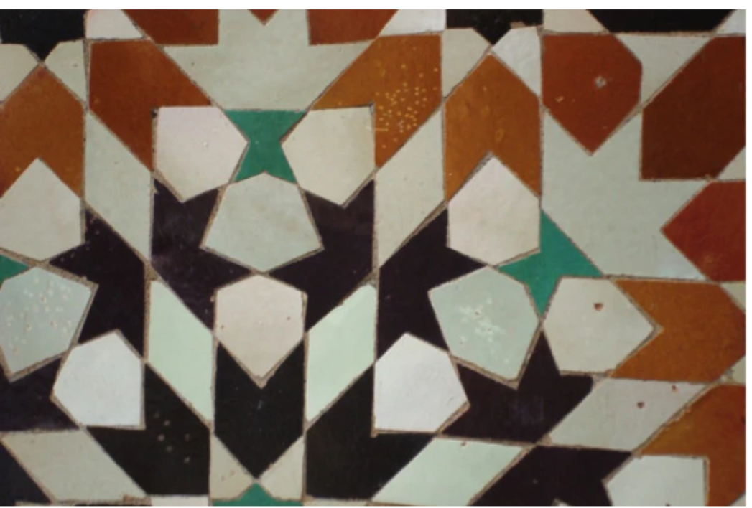
North African & Spanish Tiles
In regions like North Africa and Spain, artisans hand-cut ceramic tiles into intricate mosaics known as zellij. A stunning example is the courtyard of the 16th-century Ben Youssef Madrasa in Marrakech. Today, this tradition continues in Moroccan workshops, where artisans work meticulously to create these geometric masterpieces.

Slide 9
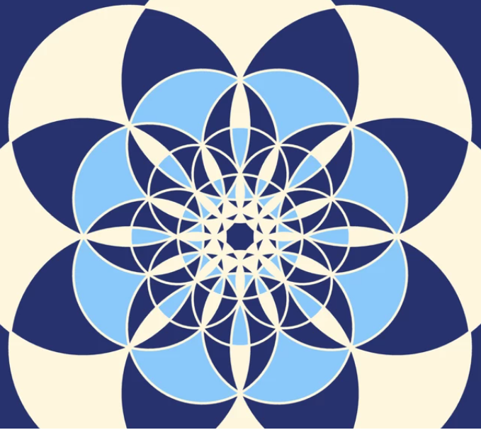
Arabic Tile Design Competition

Slide 10
Over to You! Can you design an Arabic Tile?
Tilemaker is an interactive educational tool developed by Qatar Foundation International (QFI) . It invites users to explore the beauty of Islamic art by creating vibrant, geometric tile designs.
Using Tilemaker, you can draw lines and circles to explore how simple shapes combine to form intricate geometric patterns. You can then personalise your designs with colour and creativity.
Finished tiles can be downloaded, shared, printed, or even transferred onto physical tiles—making it a perfect tool for art projects and project-based learning.
https://tilemaker.qfi.org/
COMPETITION: Design your own tile and upload in EWL Team folder by October Half Term.

