Slide 1
European Day of Languages Assembly
Kindly shared by Dr Catherine Ames
London: City of Languages Steering Group
The Grey Coat Hospital, C of E Comprehensive School for Girls

Slide 2
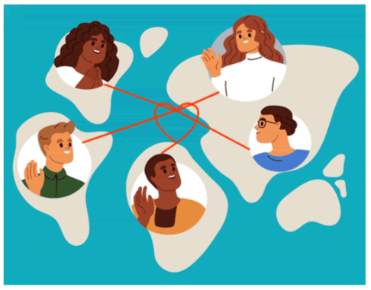

European Week of Languages 2025 Languages Open Hearts and Minds

Slide 3
Was ist deine Lieblingsfarbe?
Quelle est ta couleur préférée ?
¿ cual es tu color favorito ?
あなたの好きな色は何ですか ?
ما هو لونك المفضل؟

Slide 4
Most Europeans cite blue as their favourite colour.

Slide 5
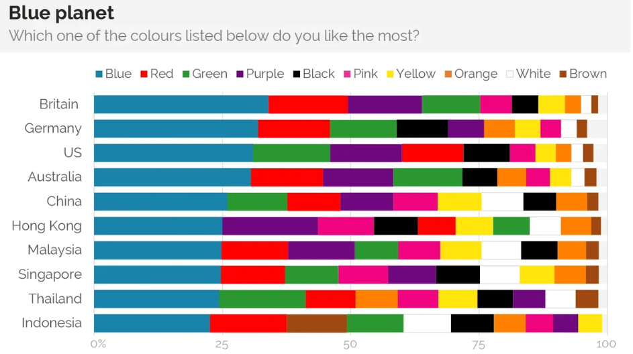
Notes:
Now why I am asking you that? You might think it’s a simple question but in fact, it shows us very plainly that taste is a question of culture and that therefore while we think we are being an individual with our own thoughts, reasons and tastes, we are actually being subtly and not so subtly drawn to particular positions and subjectivities.

Slide 6
What do you think of?
rouge
Notes:
Let’s take an obvious example. First question – what’s this colour in French?

Slide 7



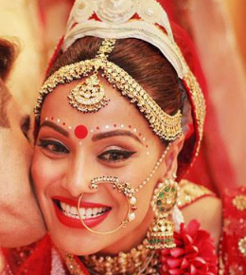

Notes:
You might think of danger, of anger, of love. I rarely red because I find it too strong and stimulating a colour but I have just bought myself a red jumper to test myself to expand my tastes. You might know that in China, red is the colour of luck, prosperity and happiness. In India red is also the colour of weddings. I once went to a wedding in Taiwan ---

Slide 8
What do you think of?
rosa
Notes:
Another one. First how do I say this colour in Spanish? And in German?

Slide 9

Femininity
Sweetness
Romance

Slide 10
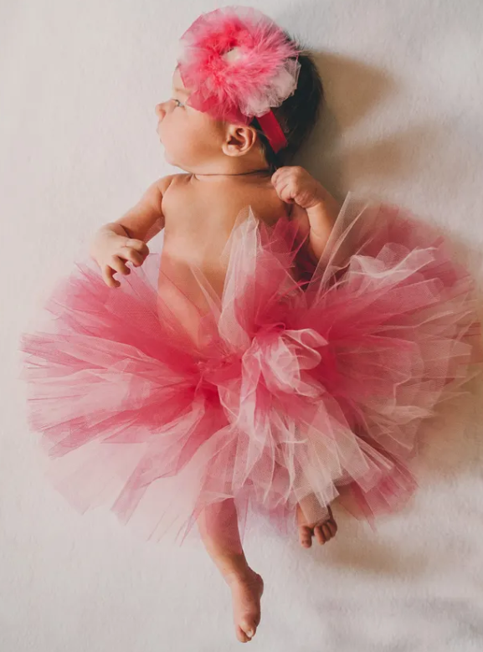
In June 1918, Ladies’ Home Journal published an article claiming that “the generally accepted rule is pink for the boys, and blue for the girls.” Pink was thought to be far too harsh of a colour for girls. Pink was considered a strong masculine choice.
Notes:
Pink is an interesting one though. The pink / blue rule used to be the other way round.

Slide 11
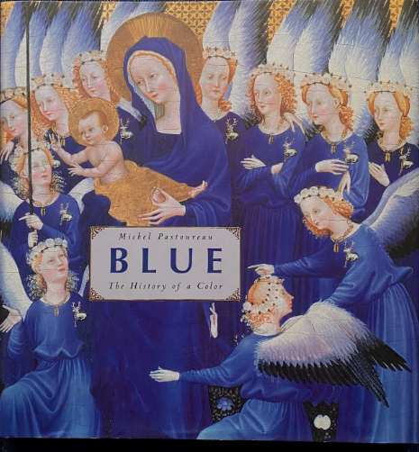
Blue: A History of A Colour
Notes:
Back to blue. I’m reading this fascinating book at the moment. The main idea is that – as we have just seen – colour is first and foremost a social phenomenon. The history of blue tells you everything you need to know about how meaning is generated, how it is contested and overturned in a cultural setting.

Slide 12
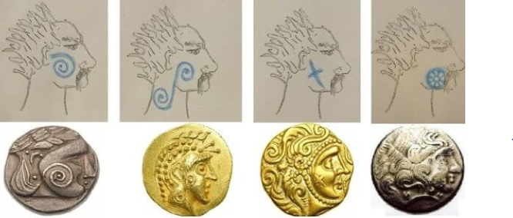
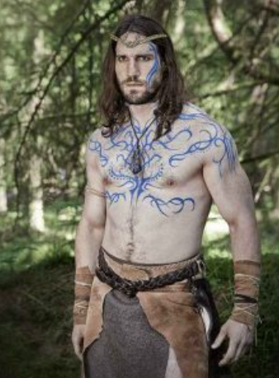
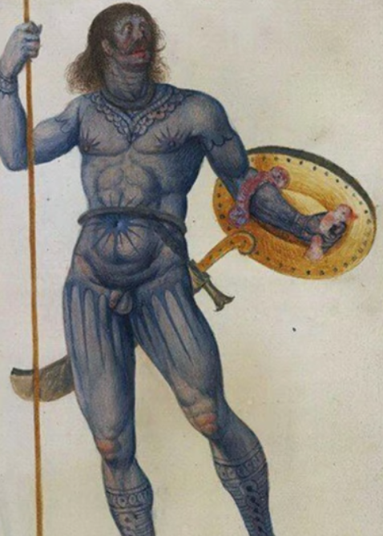
All the Britons dye themselves with woad which produces a blue colour and makes their appearance in battle more terrible. Julius Caesar, in Commentarii de Bello Gallico, Book V
Notes:
For the Romans, blue was the colour of the Barbarians. You might have heard of the Picts – the Scots (Hadrian’s Wall and all that), which is derived from the Latin word pictus, meaning painted. This dye came from a plant – woad – from the German – pastel in French, big centre near Toulouse. The Greeks and the Romans did not even acknowledge blue, blue was the colour of distrusted enemies. There is in fact no word for the colour in Latin and Ancient Greek, only approximations like glaucus which means weak as through a glass which is where we get the word glaucoma from. Having blue eyes was considered a physical inferiority, it was seen to be effeminate in men and a sign of weakness and inferiority.

Slide 13
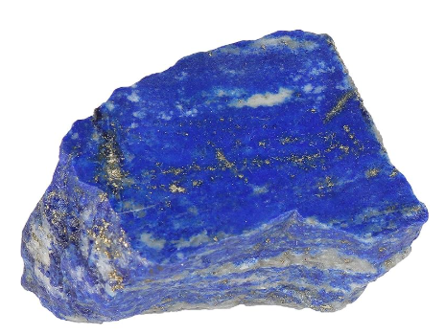
blau
bleu
Azul
أزرق
Notes:
What languages are these and what do they tell us? They tell us that the word for blue was not Latin / Greek but Germanic The word "azul" for "blue" in Spanish originates from the Medieval Latin word lazulum, which in turn comes from the Arabic word لَازُرْد ( وَlāzuward) (meaning "lapis lazuli") and the Persian lāžvard. The Arabic and Persian words referred to the deep blue stone lapis lazuli, from which the color gets its name. The word passed from Old Galician-Portuguese into Spanish, developing alongside the word azur in Old French and eventually influencing the English word azure.

Slide 14
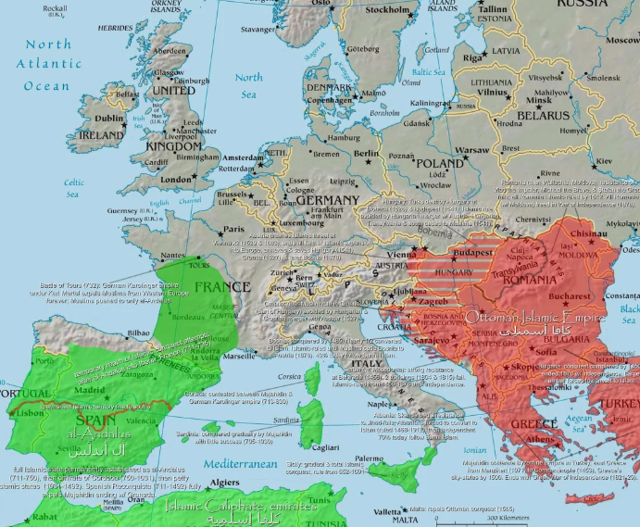
Why is the Spanish word for blue from the Arabic?
Aceite
Alcohol
Azúcar
Café
Limón
Naranja
Notes:
Islamic conquest to 12th century

Slide 15
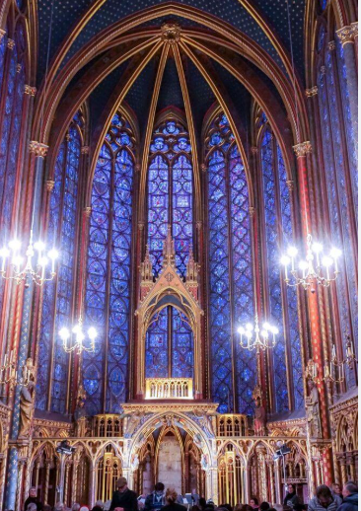
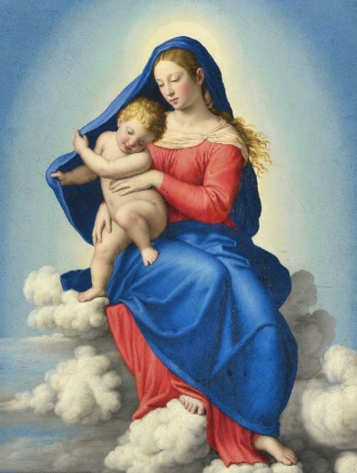
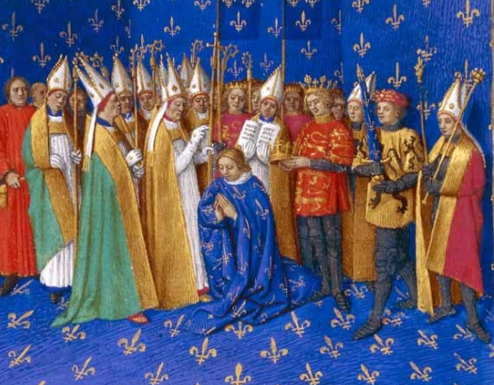
Notes:
Blue – 12th century - mini reformation – associated with aristocracy, the church and royalty.

Slide 16
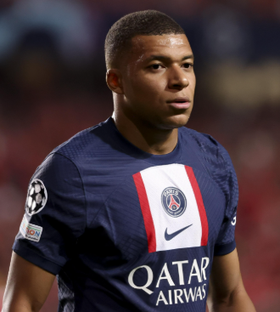



Notes:
So next time you ask someone what their favourite colour is, remember it is more complicated than you think. The way we think is profoundly influenced by the cultures we encounter and the words we use tell a story of who we are and we where come from and it’s not always what you think. It goes without saying that the more languages you learn and the more cultures you encounter, the better able you are to understand the world.

Slide 17

London: City of Languages Welcome!
https://londoncityoflanguages.org.uk/
Celebrating the superpower of languages in London

Slide 18

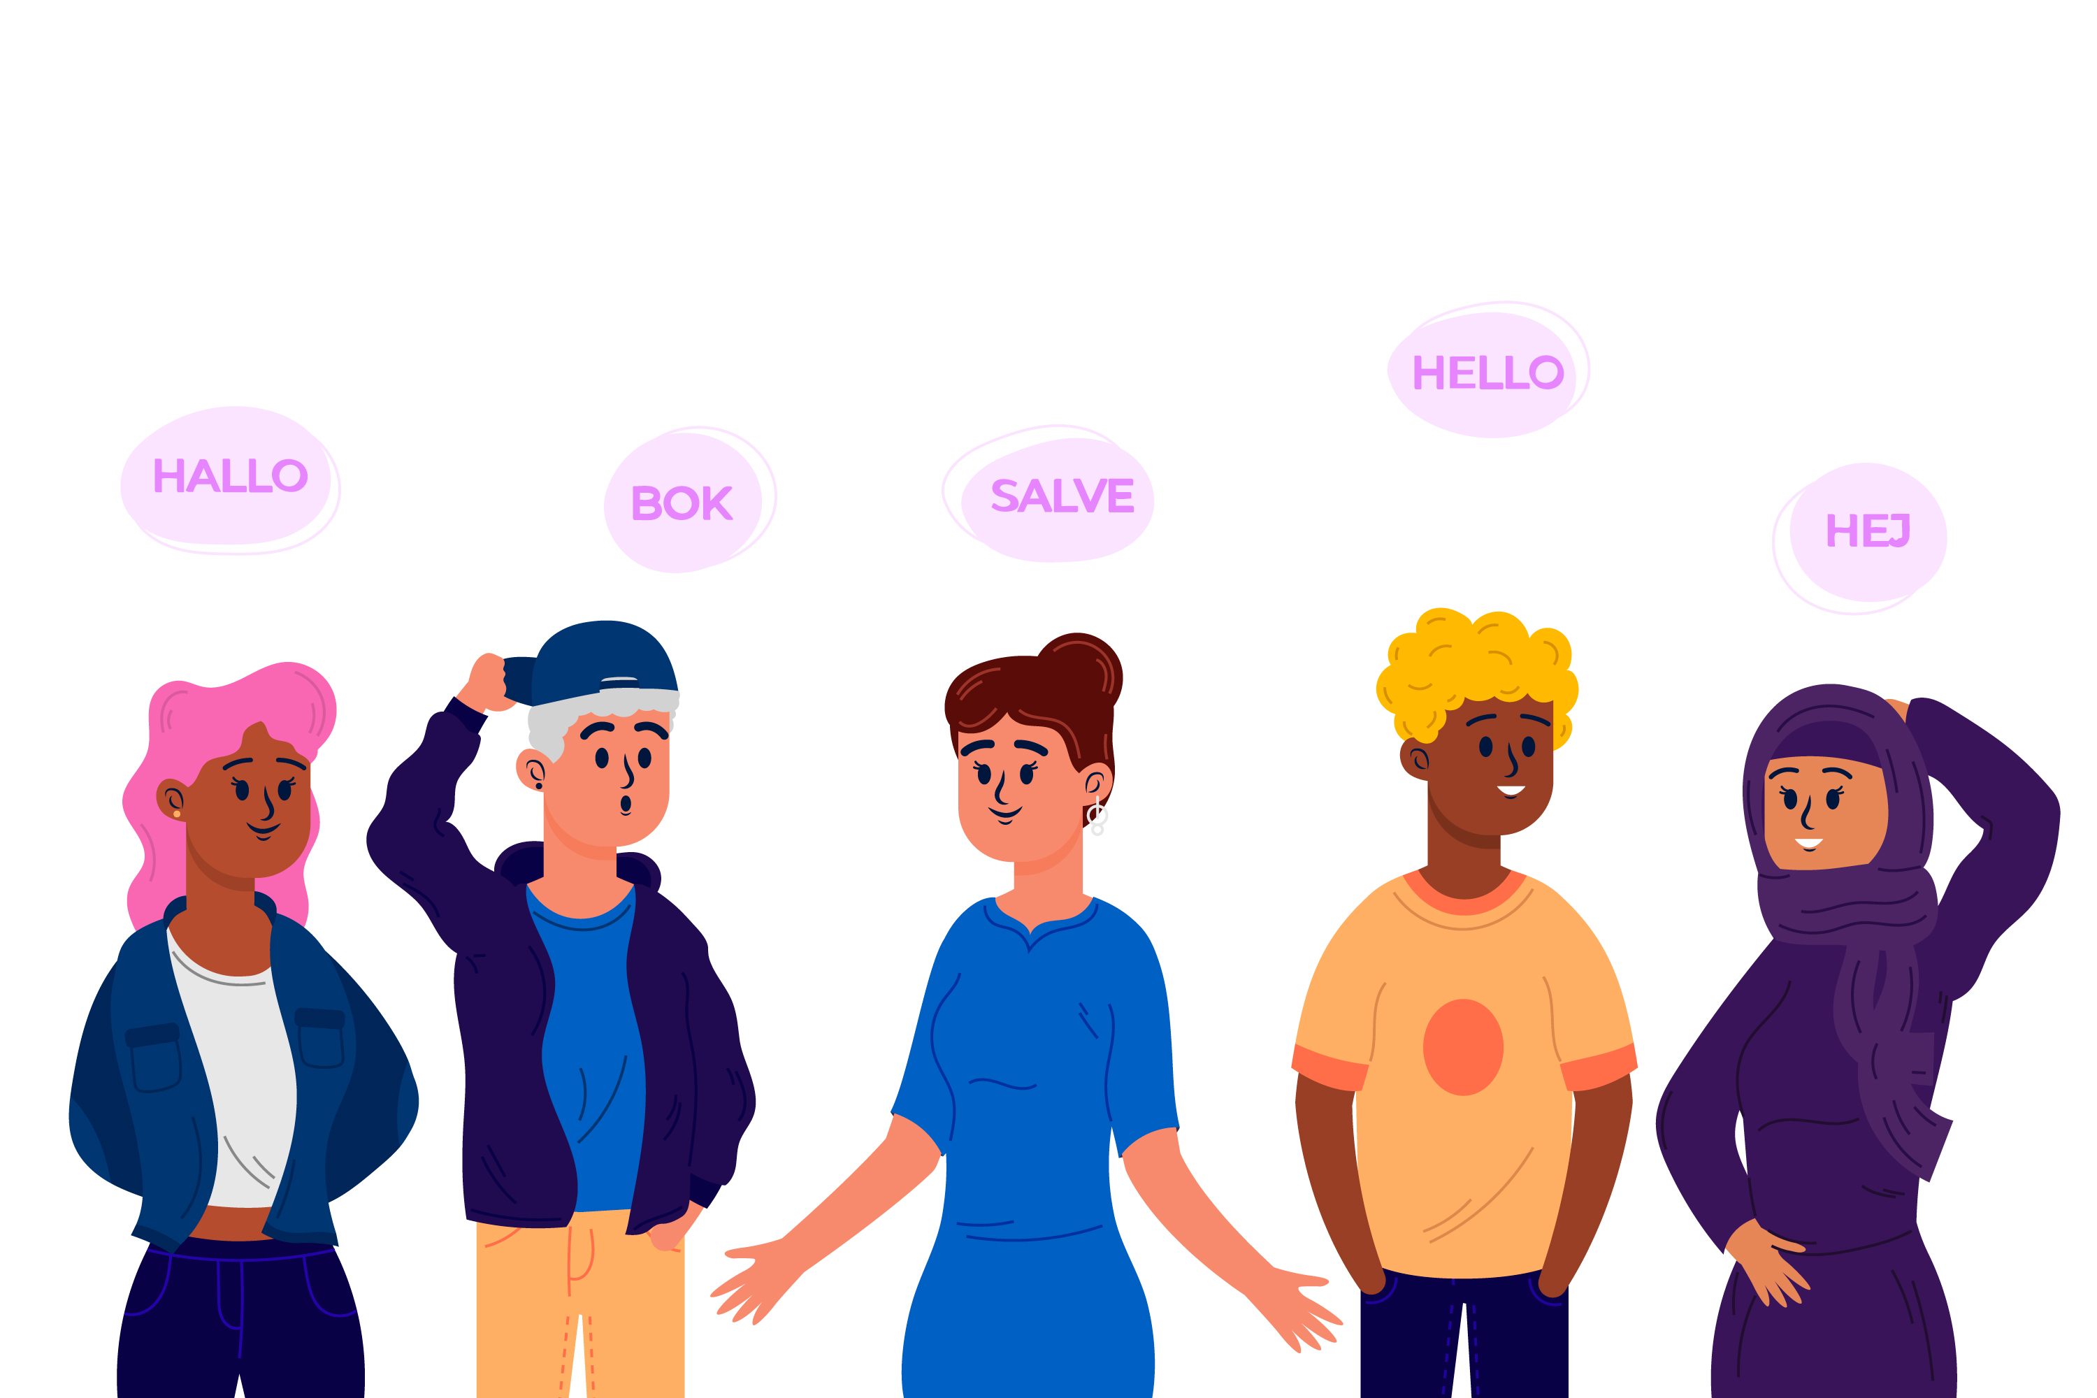
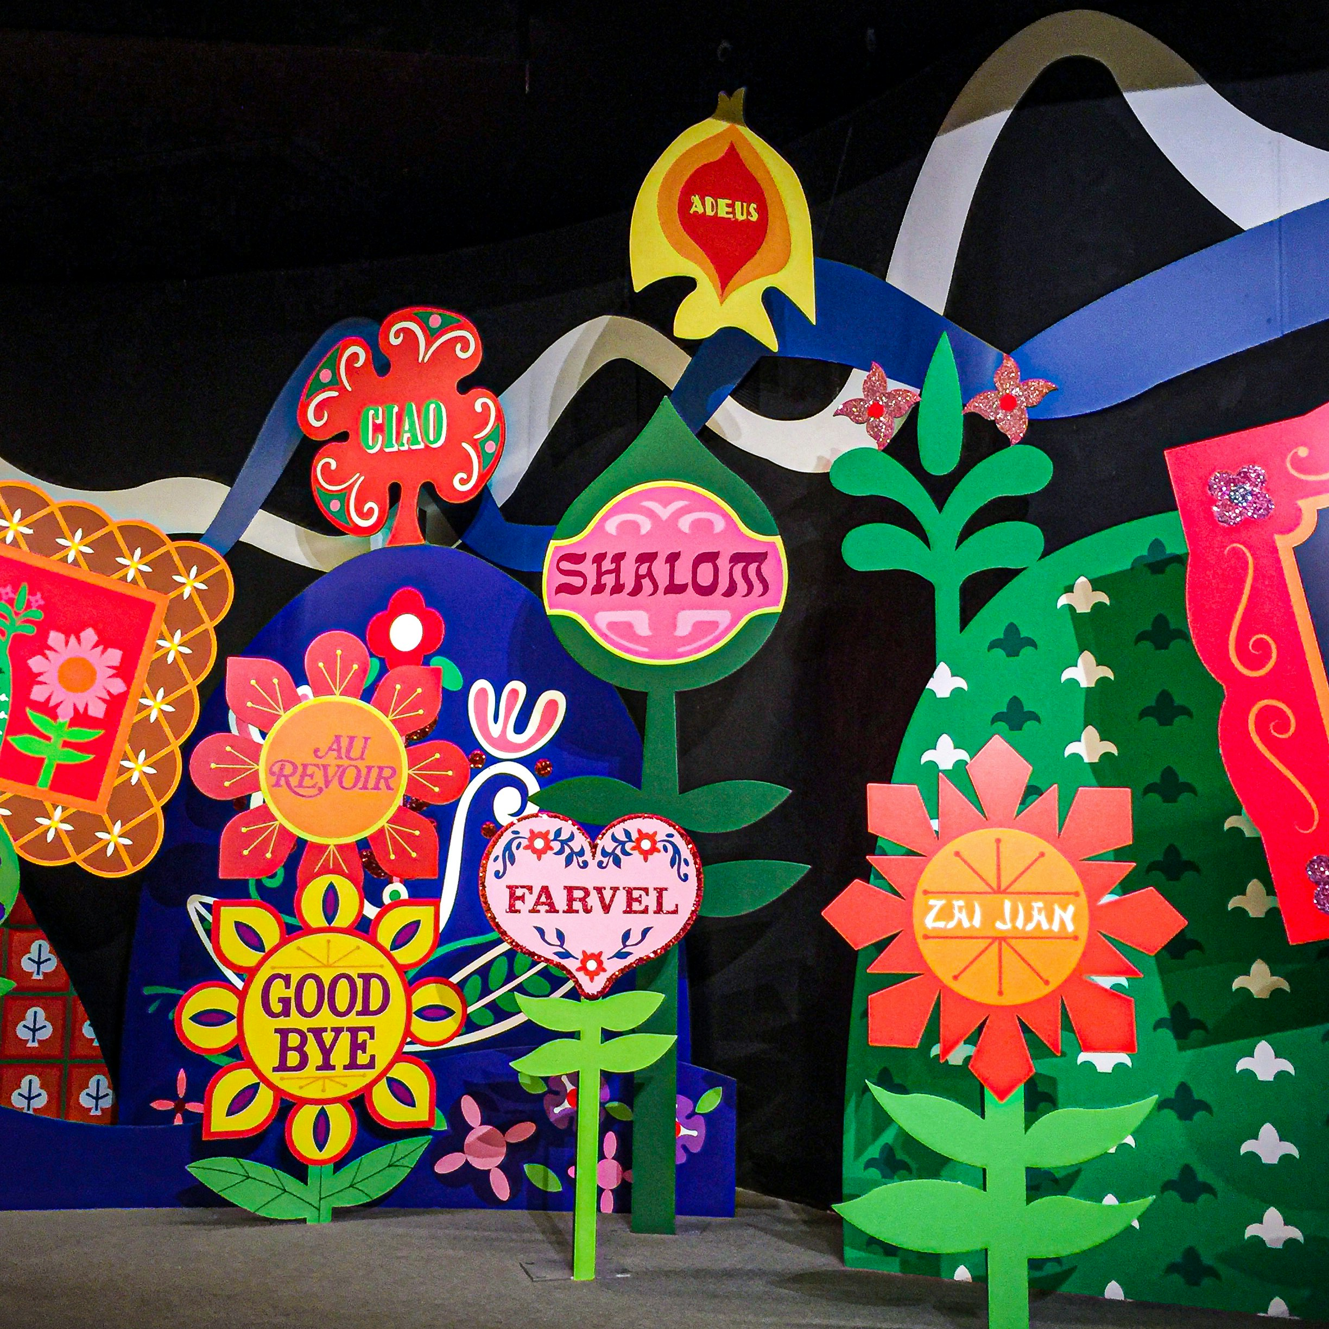
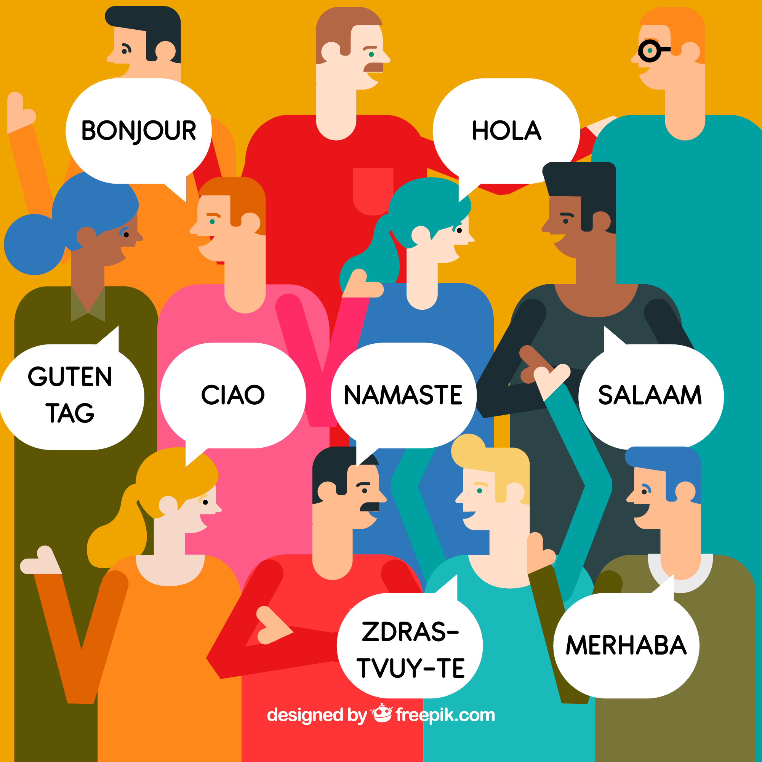
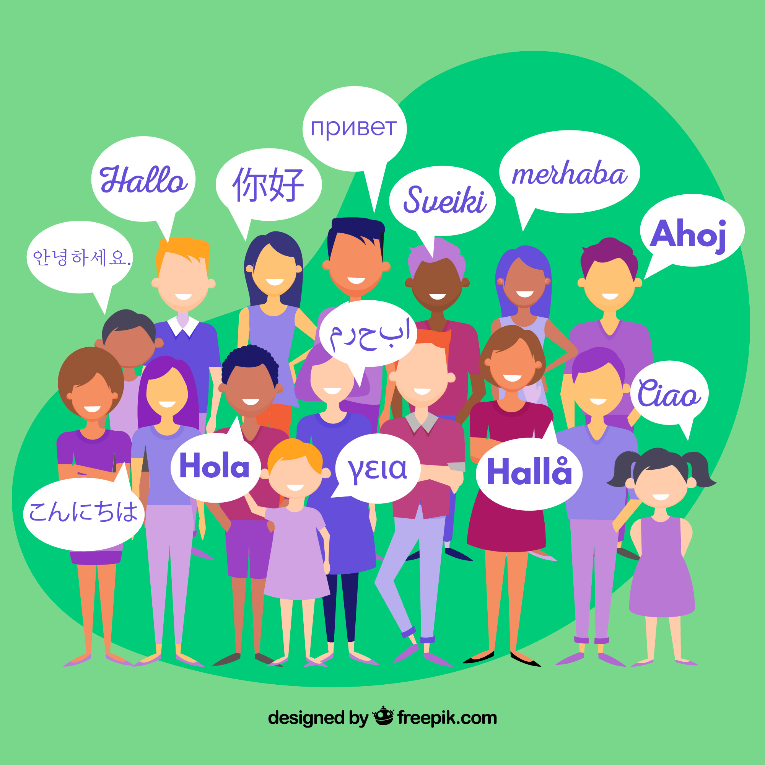

🎨 What’s the Competition About?
Design a logo that reflects London’s linguistic richness.
Winning design featured in official materials.
All entries receive a certificate; many will be featured online
Notes:
Explain logos. Show examples.

Slide 19







What You Could Win
🏅 Recognition across the city 📜 Certificate of participation 🖼️ Featured in an online gallery 🖌️ Framed version of your logo
Logos from post https://logo.com/blog/famous-logos
Notes:
Motivate with prizes.

Slide 20
Home, Heritage and Community GCSEs 2025
French | Amina Fares | 10G
French | Elizabeth Mountford, | 9R
Portuguese | Camila Oliva | 9R
Japanese | Hana Kozuma-Lewis | 10R
Russian | Anna Antypenko | 10C
Russian | Ksenia Lloyd | 8C
Mandarin | Yu Qing Yi | 10Y
Polish | Nicole Godlewska | 11H
Italian | Isabella PENNYCUICK | 9C
Italian | Anna Garrido | 10C
Spanish | Bianca Vega Zapata | 10H
Spanish | Olivia de Gouais | 10R
Spanish | Ariane Berraquero de Matharel | 9G
Spanish | Ivy Hernandez-Taylor | 10R
Persian / Farsi | Parnian Zaerimotlagh | 11H

Slide 21
Competitions
London City of Languages Logo Design
Islamic Tile Design
GCH Family Cookbook

Slide 22
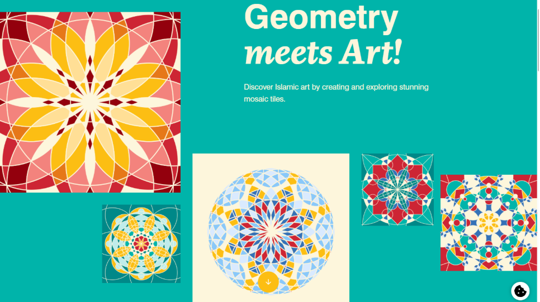

Geometry, Art and the Arab World

Slide 23
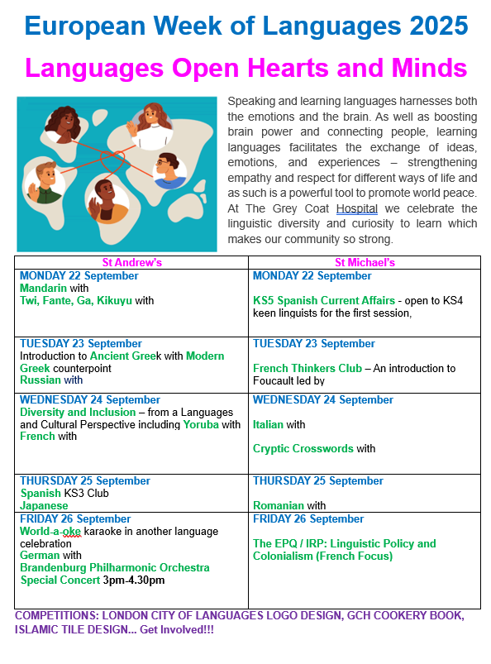

Slide 24
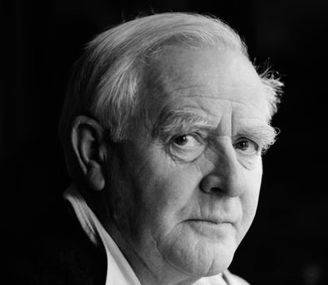
The decision to learn a foreign language is to me an act of friendship. It is indeed a holding out of the hand. It’s not just a route to negotiation. It’s also to get to know you better, to draw closer to you and your culture, your social manners and your way of thinking.

Slide 25
Matthew 5:9
"Blessed are the peacemakers, for they will be called children of God."

Slide 26
يا ربي،
نشكرْك على كلّ إنجازاتنا والفرص اللي عنا كل نهار، ونشكرْك على النعم والامتيازات اللي باركْتنا بيها. زادة نشكرْك على التنوع والثقافة اللي مدرستنا فخورة بيها. ندعيلك على كل الناس في العالم اللي ما عندهمش نفس الامتيازات ويعيشوا في فقر، حرب ولا جوع.
Dear God,
We thank you for all our achievements and opportunities we have every day and we thank you for the privileges we are blessed with. We also thank you for the diversity and culture that our school is honoured with. We pray for the people in the world who may not be so privileged and who are living in poverty, war or hunger.
Amen

